Slide 1
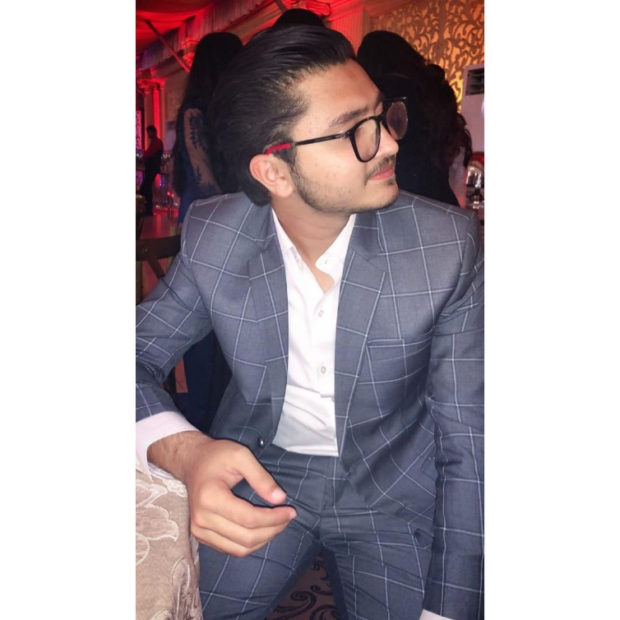
Introduction to Ahmed Ashfaq Surya

Slide 2
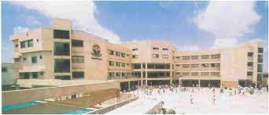
School Life
I completed my O Levels from Beacon House Jubilee Campus with a gold medal in academics.School life has been the best part of my life till date even though as a teenager you go through heartbreaks and betrayals but it helps you to unlock your true potential and find true people in your life, that’s what happened with me. I made a group of friends or more like brothers I would say, to whom I am really close and will always cherish them. I was pretty active in sports as well during my school life and represented my school at multiple forums.

Slide 3
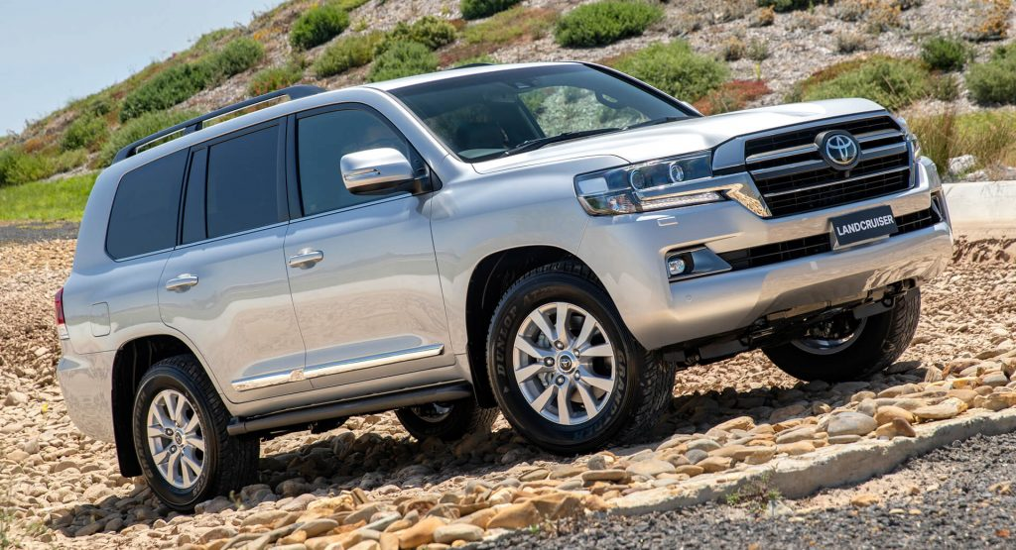
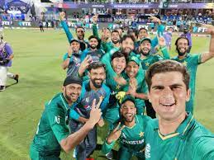
Passion
I am too passionate about cricket since my childhood and always dreamed of representing my country but due to unfavorable circumstances I was not able to do so. I still watch cricket with same passion and enjoy the gentlemen’s game. Another passion of mine is cars, I just literally love cars but unlike other mainstream car lovers I don t love sports cars instead I love luxurious cars whether be it sedan or suvs.My love for car led me to have business related to cars.

Slide 4
Qualification & Skills
I did my o levels from Beacon House and my a levels from Cedar College.
Belonging to a Memon Family, Being an Entrepreneur was my ultimate goal and I shaped my life according to that goal. My communication skills is great which is mandatory to be a successful business person.I never back off from solving any problem instead I take it as a challenge because without problem solving skill in todays World you cannot be successful.

Slide 5

Entrepreneurial Journey
Nothing comes overnight, being rich overnight is scam. It takes a lot of hard work and dedication to reach a stable stage. I started working with my father at the age of 14 at his distribution firm. Looking at my father dealing with different corporate giants gave me a hint of what is coming ahead in life and groomed me a lot. Slowly and gradually when I was completely confidant of starting my own business at the age of 20, I started with my passion of cars and started importing cars from Japan but due to covid the purchasing power of people fell drastically and my business slowed down but then came the opportunity of opening a franchise of renowned burger joint in town; “Aussie Burger Company”. Verily,Allah is the best of planners.

Slide 6
ICA Course
I am really satisfied and happy with this course as we have learned pretty important things for example excel which is very essential for book keeping in today’s business and I really enjoyed this course.

Slide 7
THANK YOU

